Slide 1
MPMCI MINI PROJECT
Implementation of Piano (8 keys) by using 8051 Microcontroller.
PRESENTED BY:
K.S.S.Keerti(1602-18-733-043)
A.V.L.LIKHITA(1602-18-733-058)

Slide 2
PROJECT DESCRIPTION:
The piano is a musical instrument played mainly by means of a keyboard. It is one of the most popular instruments in the world.
In this project, we are generating the same frequencies which are exactly same as sa re ga ma pa dha ni sa by using the 8051 microcontroller.
For this project, we have used Keil MicroVision5 as the software development environment.
For simulation, we have used Proteus 8 Professional (Schematic Capture).

Slide 3
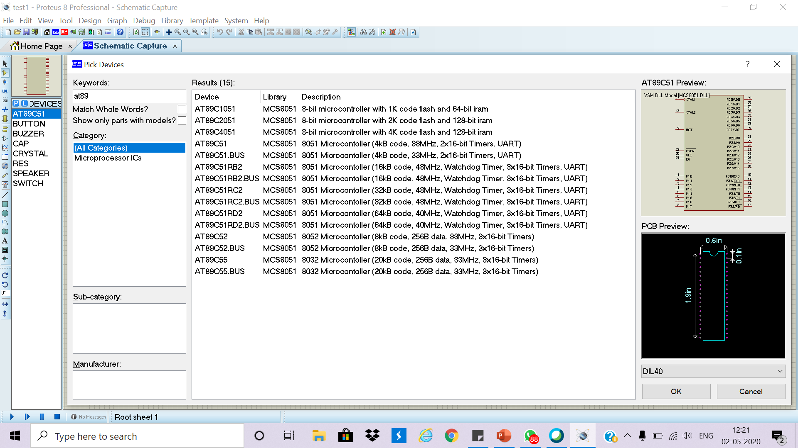
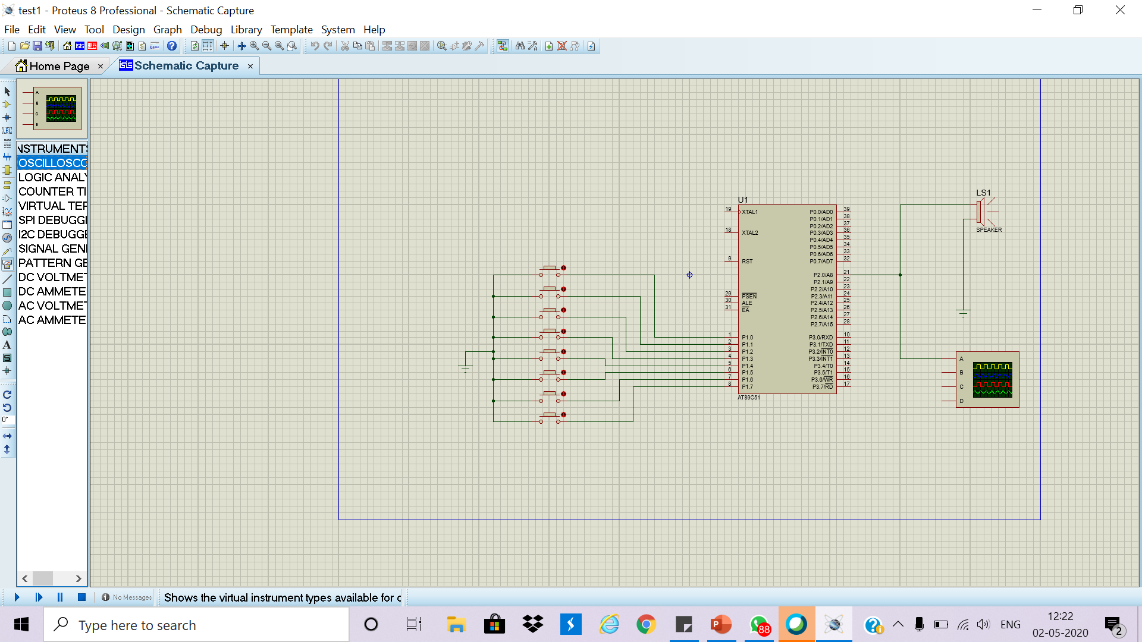
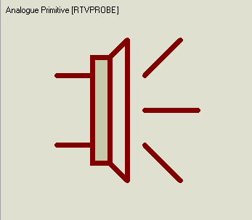
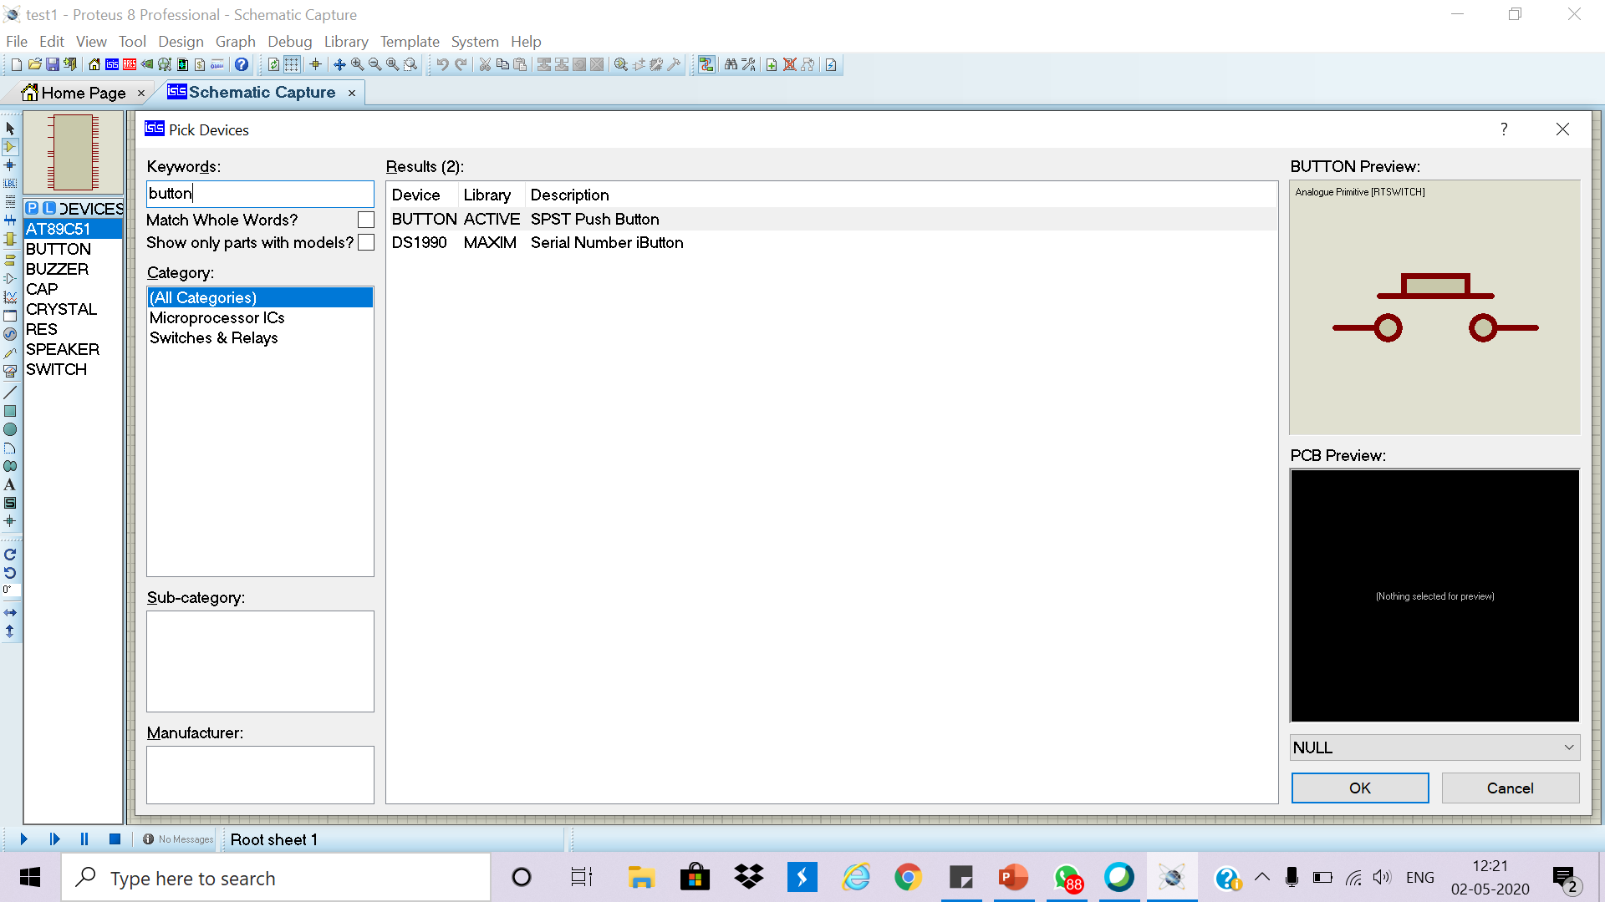
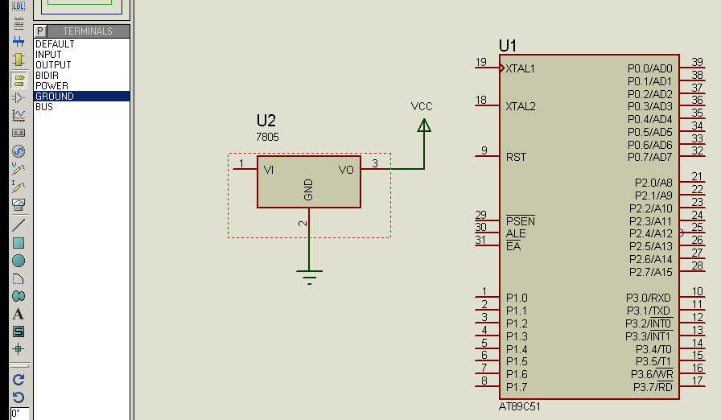
COMPONENTS USED FOR SIMULATION:
Speaker
(For audio output)
Button
(Used to simulate 8 different keys of the Piano)
Digital Oscilloscope
(For viewing the waveforms of the signals)
8051 Microcontroller
(Main component of the project)
Wires
(To connect all the components)
Terminals
(Ground)

Slide 4
8051 Microcontroller:
8051 microcontroller is designed by Intel in 1981. It is an 8-bit microcontroller.
It is built with 40 pins DIP (dual inline package), 4kb of ROM storage and 128 bytes of RAM storage, 2 16-bit timers.
It consists of are four parallel 8-bit ports, which are programmable as well as addressable as per the requirement.

Slide 5
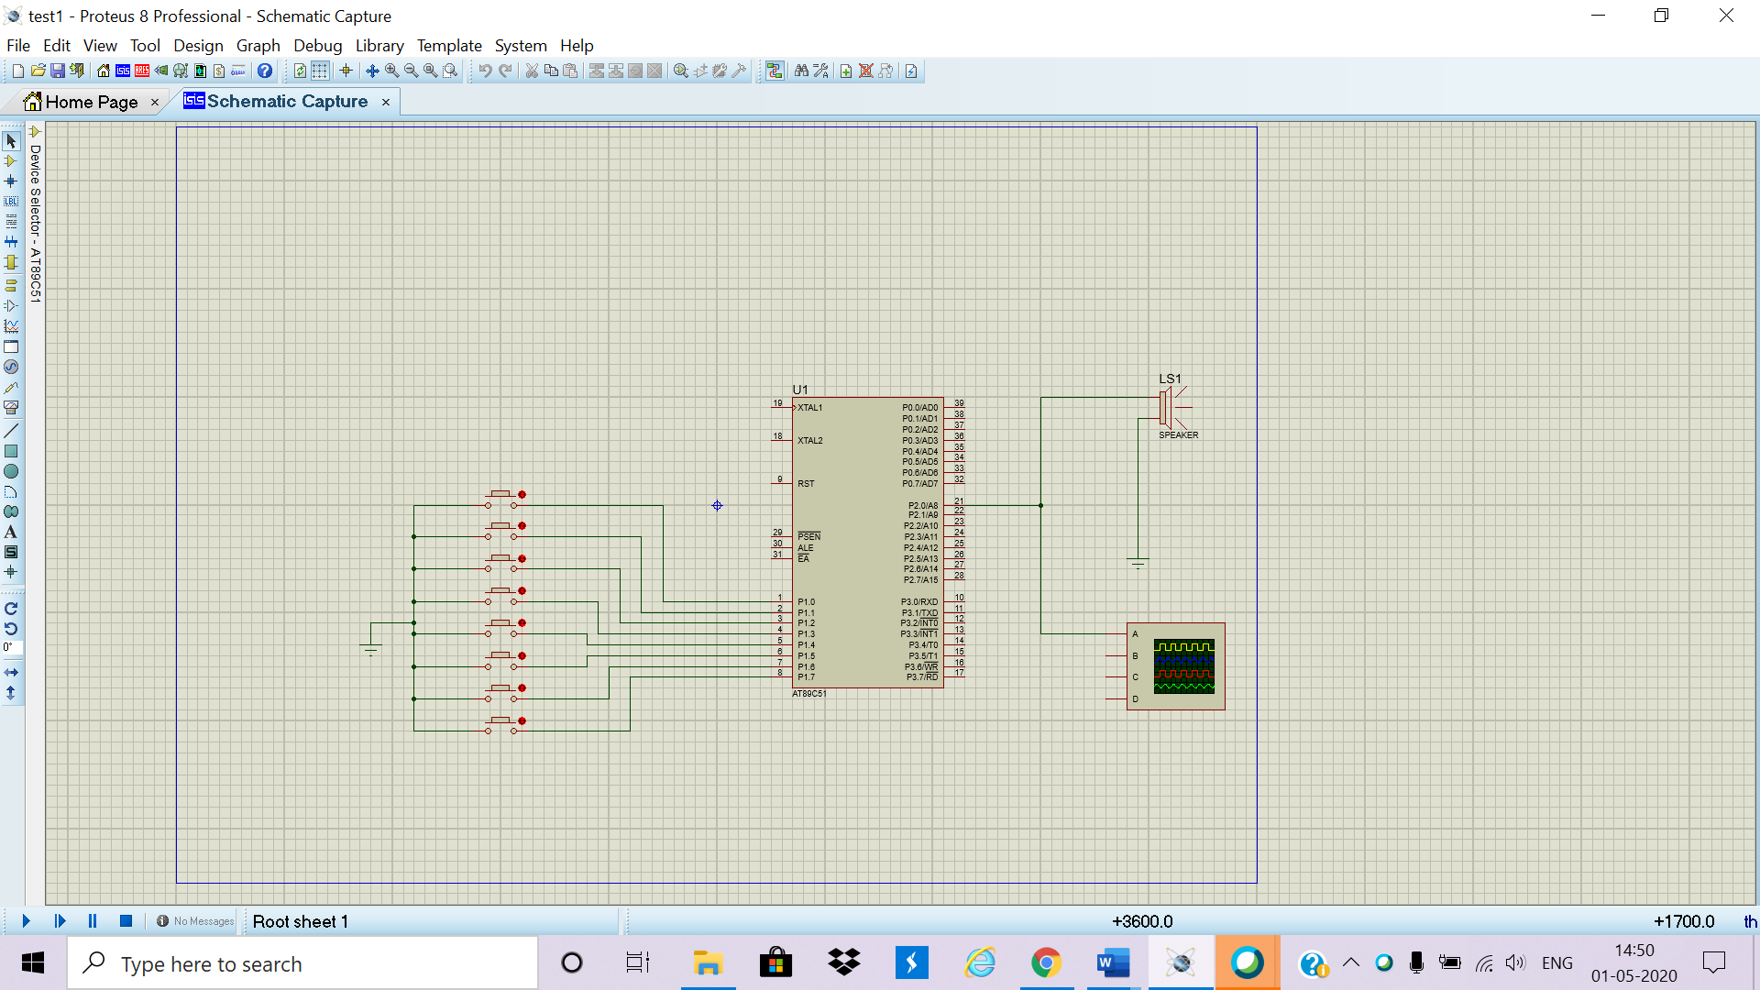
CIRCUIT DIAGRAM:

Slide 6
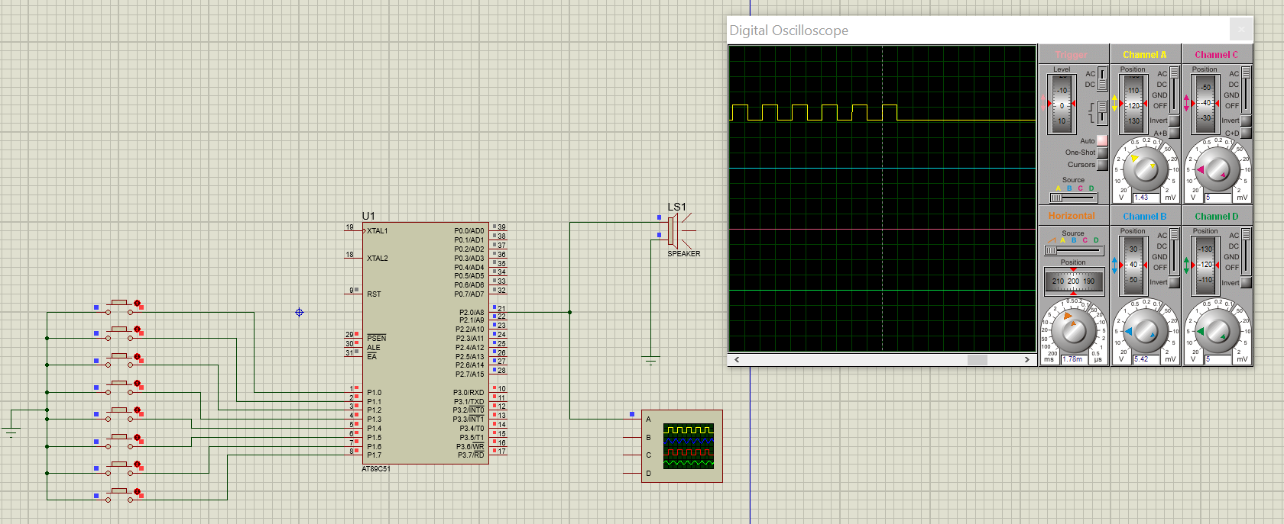
OUTPUT SCREENSHOTS:
When Key 1 is pressed(sounds like ‘sa’)

Slide 7

OUTPUT SCREENSHOTS(Contd.)
When Key 2 is pressed(sounds like ‘ri’)

Slide 8

OUTPUT SCREENSHOTS(Contd.)
When Key 3 is pressed(sounds like ‘ga’)

Slide 9
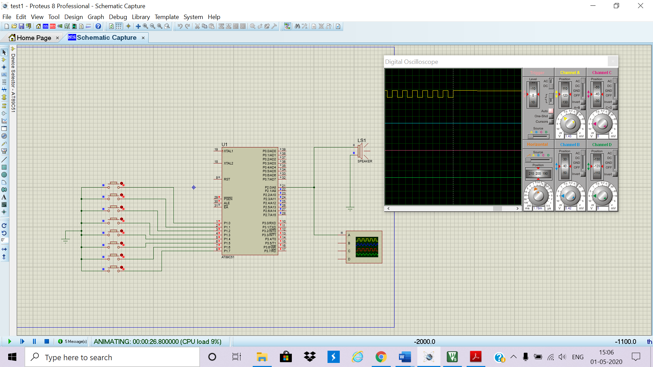
OUTPUT SCREENSHOTS(Contd.)
When Key 4 is pressed(sounds like ‘ma’)

Slide 10

OUTPUT SCREENSHOTS(Contd.)
When Key 5 is pressed(sounds like ‘pa’)

Slide 11

OUTPUT SCREENSHOTS(Contd.)
When Key 6 is pressed(sounds like ‘dha’)

Slide 12

OUTPUT SCREENSHOTS(Contd.)
When Key 7 is pressed(sounds like ‘ni’)

Slide 13

OUTPUT SCREENSHOTS(Contd.)
When Key 8 is pressed(sounds like ‘sa’)

Slide 14
CONCLUSION:
This project which could be entertaining and useful for music learners, works well as an 8 key piano that produces different frequencies of sound on key press.

Slide 15
THANK YOU

